Slide 1
Programming in C

Slide 2
General information
Course organisation
Assignments
Grading

Slide 3
Course Organization
Expected timeline is as follow. The timeline is subject to modification. In case of change you will be informed in due time.
Week 5/6  Assignment 1 submission deadline
Week 10/11  Assignment 2 submission deadline
Week 12/13  Onsite programming test
Week 16/17  Assignment 3 submission deadline

Slide 4
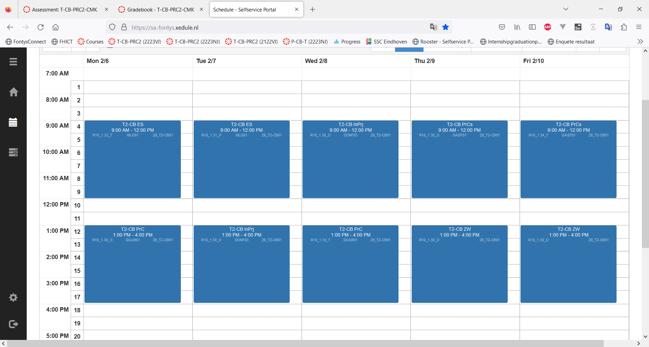
Course Organization
Example of weekly planning :

Slide 5
Course Organization
Two contact moments per week
Lesson:
3h in classroom
Teacher gives explanations, demos and guides exercises
Supported self-study:
1.5h in open space
Student initiates contact with teacher for e.g. support, informal feedback

Slide 6
Assignments
Deadlines for assignments are hard deadlines. No (re-)submission will be accepted after the deadline.
You can submit several times before the submission deadline. The latest submission before the deadline will be graded.
In case of no submission before the deadline, the corresponding assignment will not be graded.
Before the deadline: Pro-actively ask support and informal feedback
After the deadline: you may be invited to a review meeting after an assignment. If applicable your teacher will inform you in due time.

Slide 7
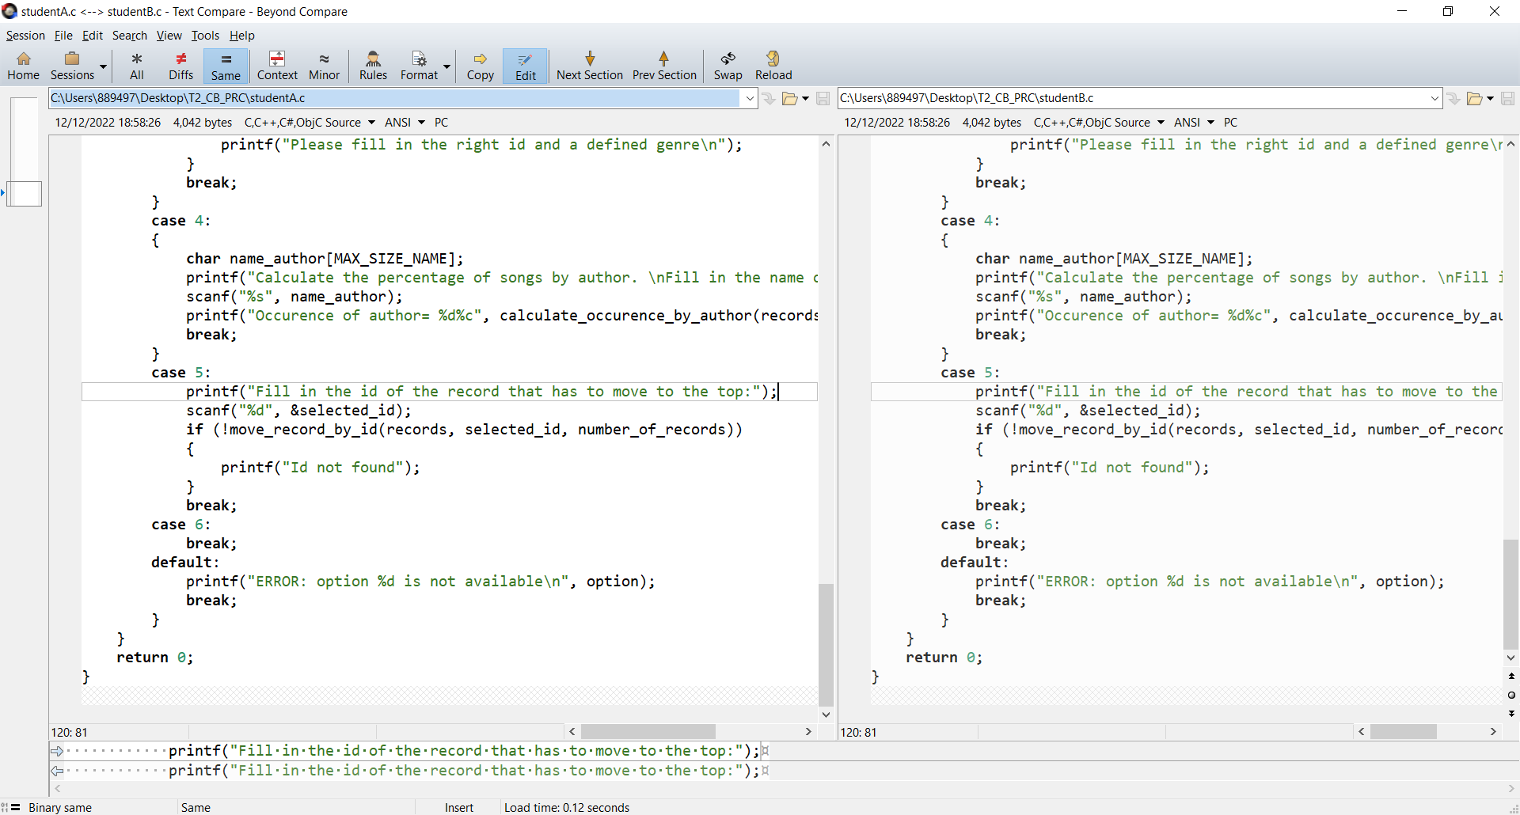
Assignments
Below the submissions of 2 students. What do you notice?
Student A
Student B

Slide 8
Assignments
Plagiarism is NOT accepted!
Your must submit your own work/code
You can discuss concepts with your classmates. However you are not allowed to share code with your classmates
You should be able to explain your code

Slide 9
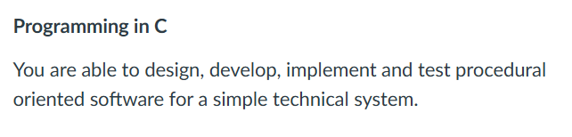
Grading
The 3 assignments and the coding test are your opportunities to show that you master the learning outcome of the course

Slide 10
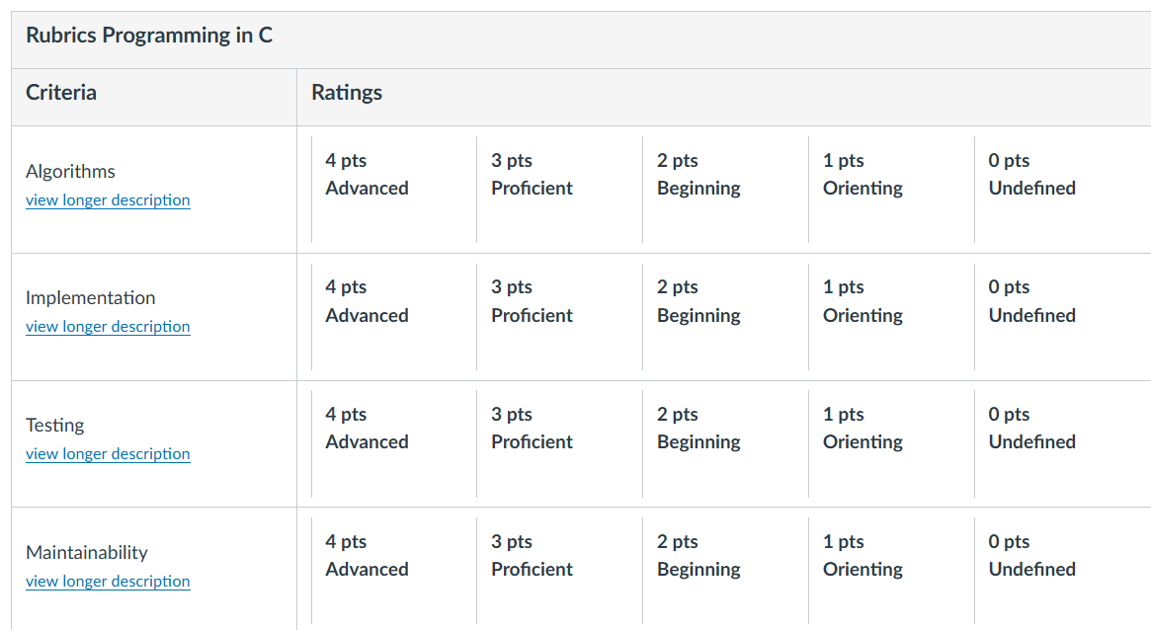
Grading
The learning outcome is assessed using 4 criteria. See the rubric in the Semester progress section of canvas.

Slide 11
Grading
Expected growth during the semester:
 | Assignment1 | Assignment2 | Coding test | Assignment3
Algorithm | Undefined | Orienting | Beginning | Proficient
Implementation | Orienting | Beginning | Beginning (Confirmation) | Proficient
Testing | Undefined | Orienting | Beginning | Proficient
Maintainability | Orienting | Beginning | Beginning (Confirmation) | Proficient

Slide 12
Warm up
History of C
Applications of C
Set up the environment

Slide 13
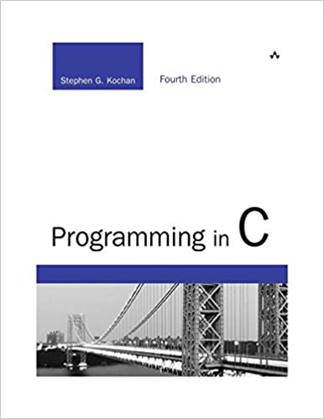
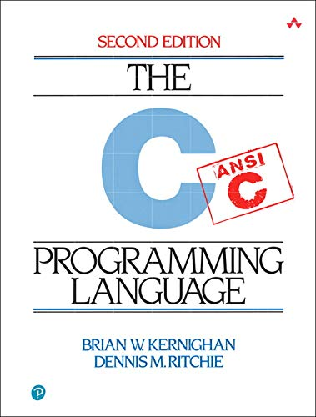
History of C
1972 C (Ritchie & Kerninghan)
1983 C++
1995 Java
2000 C#

Slide 14
Applications of C
Hardware control (bit operation)
Embedded systems (small memory, fast to execute)
Compilers
Operating systems

Slide 15
Setting up the environment
Microsoft Visual Studio Code (See installation manual in Canvas)

Slide 16
Week 1
Arrays and Strings

Slide 17
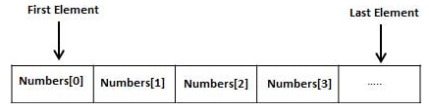
Array
Definition:
Data structure with a fixed-size variables of the same type
The variables in the array are indexed with sequence

Slide 18
Array
Declaration: type arrayName[arraySize]
char message[5];
int score[5];
float temperature[24];

Slide 19
Array
Initialization:
One by one:
score[0] = 8;
score[1] = 6;
score[2] = 7;
…
Declare and initialize in one statement:
int score[5] = {8, 6, 7, 5, 9};
Declare and initialize in one statement (size can be omitted):
int score[] = {8, 6, 7, 5, 9};
Initialize first element. The remaining elements are set to 0:
int score[5] = {8};

Slide 20
Array
Accessing array element:
int math = score[0];
int physics = score[1];
…

Slide 21
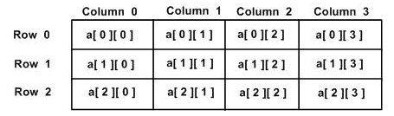
Multi-dimentional Array
Declaration: type array[size1][size2][size3]…
int average[256];
int pixel[256][256]; //declaration
for (int i = 0; i < 256; i++) //initialization
for (int j = 0; j < 256, j++)
pixel[i][j] = 0;
…
for (int i = 0; i < 256; i++) //accessing the value
{
int sum = 0;
for (int j = 0; j < 256, j++)
sum += pixel[i][j];
average[i] = sum/256;
}

Slide 22
Input and output: scanf and printf
#include <stdio.h>
int main()
{
int a;
float b;
printf("Enter integer and then a float: ");
// Taking multiple inputs
scanf("%d %f", &a, &b);
printf("You entered %d and %f", a, b);
return 0;
}
Data Type | Format specifier
int | %d
char | %c
float | %f
double | %lf
short int | %hd
unsigned int | %u
long int | %ld
long long int | %lld
unsigned long int | %lu
unsigned long long int | %llu
signed char | %c
unsigned char | %c
long double | %lf

Slide 23
Exercise
Declare an integer array of size 10. Initialize each element of the array with a value. Calculate the average value of the array. Write the average value to the terminal.
Find the maximum value of the above array. Write the maximum value to the terminal.
Notes:
Convert to descending order: 1. create a new array, reverse assigning the value, copy back
2. create a temp value, compare each a[i] with a[j], and swap the value

Slide 24
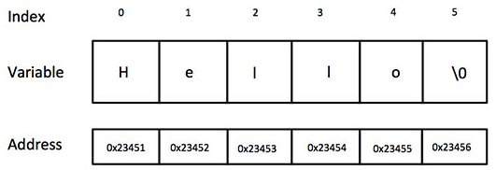
String
Definition:
One-dimensional array of characters terminated by a null character ‘\0’
char greeting[] = “Hello”;

Slide 25
String
Useful functions for string:
scanf(“%s”, s): read string from terminal and copy to string s
strcpy(s1, s2): copy string s2 into string s1
strcat(s1, s2): concatenate string s2 at the end of s1
strlen(s1): return the number of characters of string s1
strcmp(s1, s2): compare two strings, returns 0 if s1 and s2 are the same, returns a value different than 0 is s1 and s2 are not the same
printf(“%s”, s): write string s to terminal
Need to include library string.h
Notes:
Problem of strcpy: The strcpy() function does not specify the size of the destination array, so buffer overrun is often a risk. Here destination is not large
// enough to store the src. so the
// behaviour of strcpy is unspecified.
// program may crashed
Problem of strncpy: If there is no null character among the first n character of src, the string placed in dest will not be null-terminated. The strlen() non-terminated string can cause segfault. In other words, non-terminated string in C/C++ is a time-bomb just waiting to destroy code.
strcpy < strncpy < snprintf < strlcpy
snprintf
strlcpy

Slide 26
fgets, gets, strlen, sizeof
#include <stdio.h>
#include <string.h>
int main()
{
char a[50];
int length;
/* to take a single string (including spaces) as input at a time */
gets(a);
/* fgets(a, 15, stdin); */
/* Return the length of the string or the number of characters in the string */
length = strlen(a);
printf("The length of the input string is: %d\n\n", length);
return 0;
}
#include<stdio.h>
#include<string.h>
int main()
{
char s[] = "Studytonight";
int length1, length2;
length1 = sizeof(s);
length2 = strlen(s);
// need to put in backslash in front to print the quote symbol
printf("sizeof() of string \"Studytonight\" returns %d and strlen() returns %d.", length1, length2);
return 0;
}
Notice the lower case “s”
What is the difference of the length
What is the difference of the string
Notes:
What is the difference between scanf and gets/fgets?
Tips for gets, better use fgets
Fgets: it reads from a line from a specified stream (in this case, standard input, keyboard) and stores it in a string. It stops when either (n-1) characters are read, the newline character is read, or the end-of-file is reached, whichever comes first
Gets: Reads characters from the standard input (stdin) and stores it into str until a newline character or the end-of-file is reached. It does not check array bound.

Slide 27
Exercise
Declare and initialize a string consisting of several words (i.e. a sentence). Count the the number of words in the sentence. Write the number of words to the terminal.
Write a program to detect if a word is a palindrome or not.
Notes:
Problem of strcpy: The strcpy() function does not specify the size of the destination array, so buffer overrun is often a risk. Here destination is not large
// enough to store the src. so the
// behaviour of strcpy is unspecified.
// program may crashed
Problem of strncpy: If there is no null character among the first n character of src, the string placed in dest will not be null-terminated. The strlen() non-terminated string can cause segfault. In other words, non-terminated string in C/C++ is a time-bomb just waiting to destroy code.
strcpy < strncpy < snprintf < strlcpy
snprintf
strlcpy

Slide 28
References
Documentation of the C standard library:
https://www.cplusplus.com/reference/clibrary/
Definition of ASCII:
https://www.ascii-code.com/
Fontys installation guide of Visual Studio Code:
https://fhict.instructure.com/courses/12897/modules

